Slide 1
GDP Analysis

Slide 2
Section IA - GDP Analysis of the Indian States
Section II - GDP Analysis of the Indian States except Union Territories
Section III - GDP Analysis of the Categorised Indian States (C1, C2, C3, C4) (excluding Union Territories)
Section IV - Recommendations Section V - GDP and Education Dropout Rates

Slide 3
Section IA - GDP Analysis of the Indian States
This section includes all states, except West Bengal since the data for West Bengal was not available at this stage. Below details are covered:
Average growth rate of all states for 2013-14, 2014-15 and 2015-16 over All India GDP (Page 4)
GDP of the states for the year 2015-16 (Page 5)

Slide 4
Average growth of states for 2013-14, 2014-15 and 2015-16
Graph is the average growth rate of all states
Top 3 states which are above overall GDP average growth rate (All India) ?
Ans: Mizoram, Tripura, Nagaland
Bottom 3 states which are below overall GDP average growth rate (All India)?
Ans: Goa, Meghalaya, Odissa
Karnataka’s average growth rate? Above or below national average?
Ans: 14.12%. Above the National Average.

Slide 5
GDP of the states for the year 2015-16
Top 5 states based on GDP?
Ans: Tamil Nadu, Uttar Pradesh, Karnataka, Gujrath, Andra Pradesh.
Bottom 5 states based on GDP?
Ans: Andaman and Nicobar, Tripura, Rajasthan, Punjab and Nagaland

Slide 6
Section II - GDP Analysis of the Indian States except Union Territories
This section includes all states, except West Bengal and all Union Territories. This covers for other 28 states This section has majorly focused only for 2014-15 stats and cover below details
GDP per capita for all the states
Contribution of primary, secondary and tertiary sectors as percentage over GDP

Slide 7
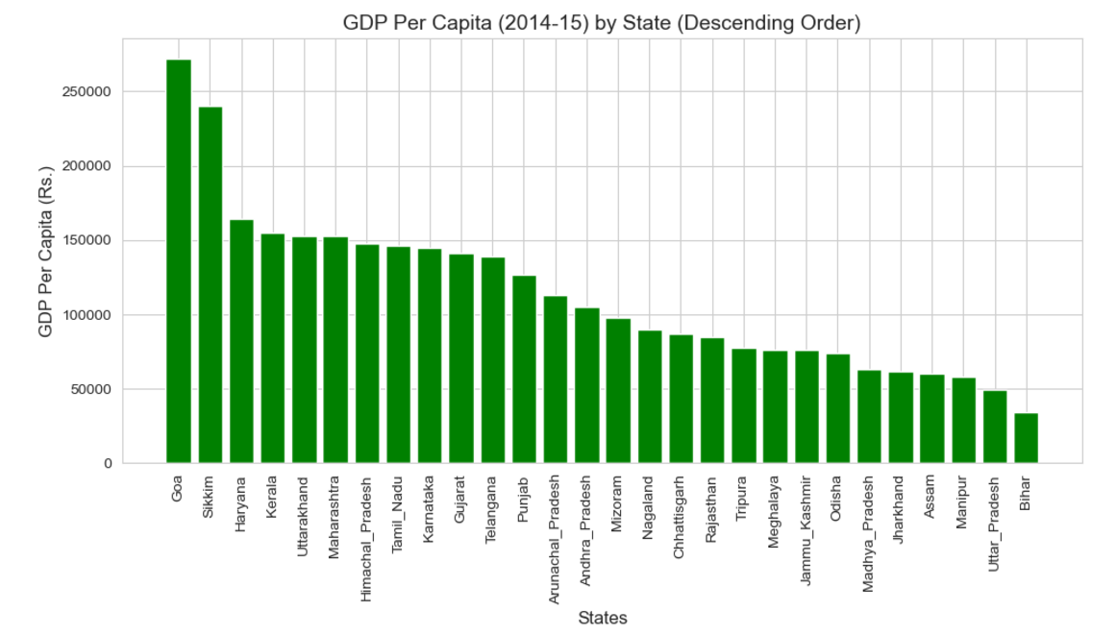
GDP per capita for all the states – 2014-15
State | GDP per capita
Goa | 271793.0
Sikkim | 240274.0
Haryana | 164077.0
Kerala | 154778.0
Uttarakhand | 153076.0
Maharashtra | 152853.0
Himachal_Pradesh | 147330.0
Tamil_Nadu | 146503.0
Karnataka | 145141.0
Gujarat | 141263.0
Telangana | 139035.0
Punjab | 126606.0
Arunachal_Pradesh | 112718.0
Andhra_Pradesh | 104977.0
Mizoram | 97687.0
Nagaland | 89607.0
Jammu_Kashmir | 75840.0
Odisha | 73979.0
Madhya_Pradesh | 62989.0
Jharkhand | 62091.0
Assam | 60621.0
Manipur | 58442.0
Uttar_Pradesh | 49450.0
Bihar | 33954.0
Chhattisgarh | 86860.0
Rajasthan | 84837.0
Tripura | 77358.0
Meghalaya | 76228.0

Slide 8
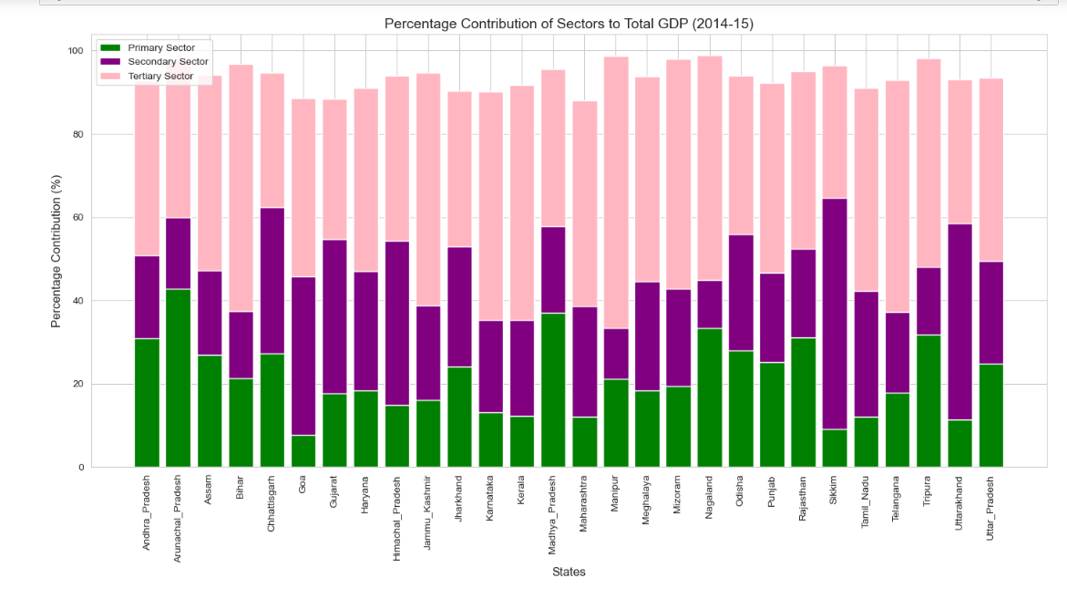
Contribution of primary, secondary and tertiary sectors as percentage over GDP

Slide 9
Section III - GDP Analysis of the Indian States except Union Territories
This section includes all states, except West Bengal and all Union Territories. This covers for other 28 states This section has majorly focused only for 2014-15 stats and cover below details
This section has additionally focused on dividing each states in to categories to understand which states are playing major role in contributing to GDP
Details of category split is covered in page 10 and below other details are captured
C1 States - Sub-Sectors contributing towards GDP (Page 11)
C2 States - Sub-Sectors contributing towards GDP (Page 12)
C3 States - Sub-Sectors contributing towards GDP (Page 13)
➢C4 States - Sub-Sectors contributing towards GDP (Page 14)

Slide 10
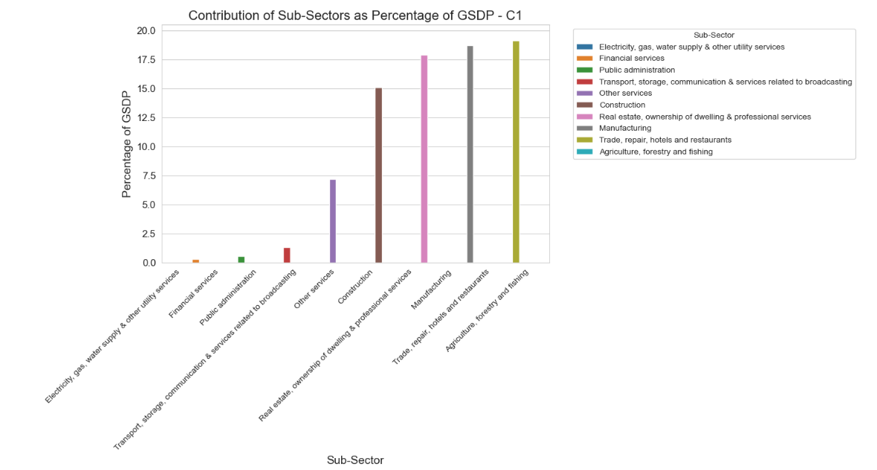
C1 States - Sub-Sectors contributing towards GDP
Major Sub-sectors contributing to GSDP are:
Agriculture, forestry and fishing
Trade, repair, hotels and restaurants
Manufacturing
Real estate, ownership of dwelling & professional service
Construction
C1 States
Goa
Sikkim
Haryana
Kerala

Slide 11
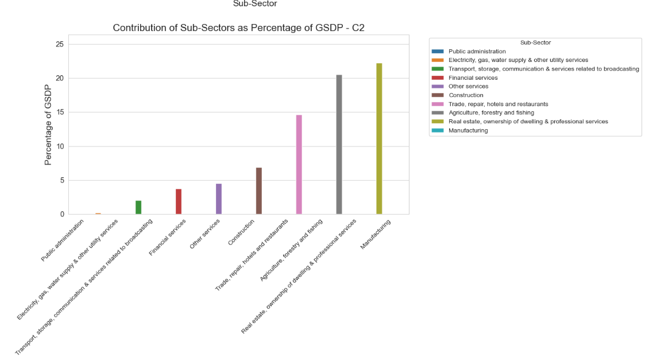
C2 States - Sub-Sectors contributing towards GDP
Major Sub-sectors contributing to GSDP are:
Manufacturing
Real estate, ownership of dwelling & professional service
Agriculture, forestry and fishing
Trade, repair, hotels and restaurants
Construction
C3 States
Maharashtra
Himachal_Pradesh
Tamil_Nadu
Karnataka
Gujarat
Telangana
Punjab
Arunachal_Pradesh
Andhra_Pradesh

Slide 12
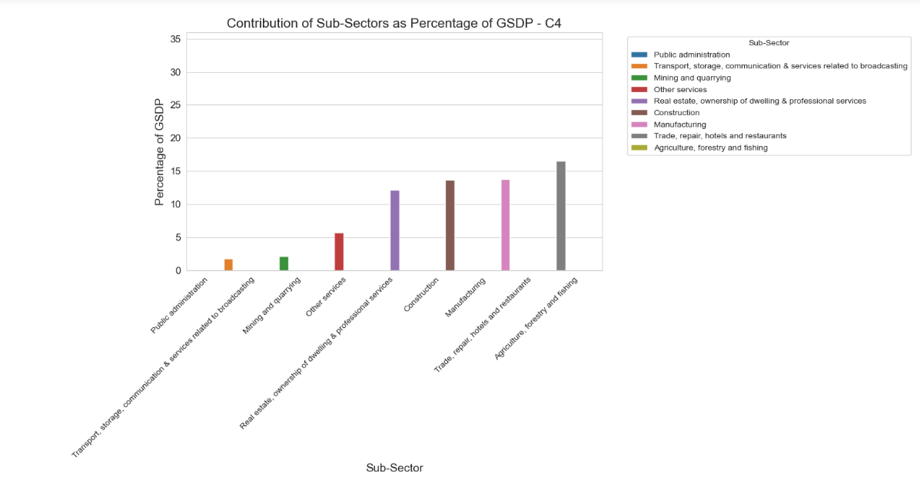
C4 States - Sub-Sectors contributing towards GDP
Major Sub-sectors contributing to GSDP are:
Agriculture, forestry and fishing
Trade, repair, hotels and restaurants
Manufacturing
Construction
Real estate, ownership of dwelling & professional service
C4 States
Madhya Pradesh
Jharkhand
Assam
Manipur
Uttar Pradesh
Bihar

Slide 13
Findings / Recommendations
Category C1 (Low GDP States):
Enhance Manufacturing and Infrastructure: Invest in manufacturing and construction sectors to create more employment opportunities and infrastructure development, boosting local economies.
Focus on Skill Development and Education: Prioritize skill development programs and higher education, particularly in sectors like trade, services, and manufacturing, to increase workforce productivity and attract more investments.
Category C2 (Medium GDP States):
Boost Trade and Services: Strengthen trade, retail, and service sectors like hospitality to drive economic growth, especially in urban areas, creating more jobs and diversifying the economy.
Increase Investment in Renewable Energy: Invest in renewable energy and infrastructure, such as electricity and water supply, to foster sustainable development, ensuring long-term economic stability.
Category C3 (High GDP States):
Invest in Technology and Innovation: Focus on technological advancements, research and development (R&D), and innovation in sectors like IT and financial services to maintain competitive advantage and enhance economic output.
Improve Healthcare and Public Administration: Enhance healthcare and administrative systems to ensure a better quality of life, improve labor productivity, and increase the attractiveness of the state to investors.
Category C4 (Highest GDP States):
Diversify Economy: Reduce dependence on a few sectors like real estate and manufacturing by encouraging diversification into emerging sectors such as financial services, tourism, and information technology.
Promote Green and Sustainable Practices: Invest in green technologies, sustainable agriculture, and eco-friendly infrastructure to drive growth while preserving resources, which can attract future investments

Slide 14
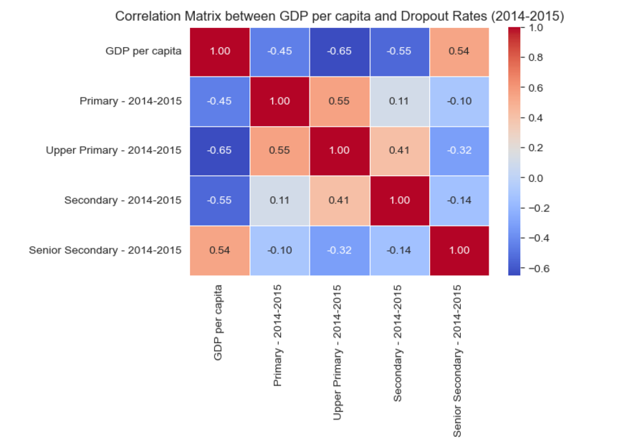
Section V - Section V - GDP and Education Dropout Rates
Key Insights:
Negative Correlation: Higher GDP per capita generally correlates with lower dropout rates, suggesting better access to education and resources in wealthier states.
Higher Dropout Rates in Lower-GDP States: States with lower GDP tend to have higher dropout rates due to financial constraints and limited educational resources.
Regional Variation: The relationship between GDP and dropout rates differs across states, indicating other factors like cultural influences, education policies, and infrastructure also play a role.
Primary Education: Stronger correlation between GDP and dropout rates at the primary level.
Secondary & Senior Secondary: Weaker correlation at higher education levels, suggesting cost and perceived value may still hinder retention in lower-GDP states.
Other Socioeconomic Factors: GDP alone doesn't fully explain dropout rates; factors like parental education, gender, and rural-urban disparities also influence retention.

